Slide 1
Research Center for Artificial Intelligence in Science and Society (RAIS²)

Slide 2
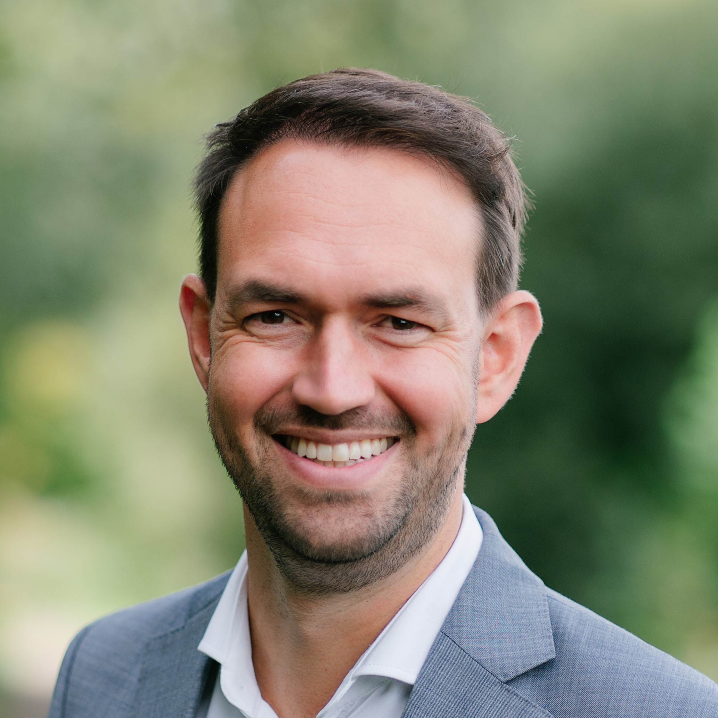
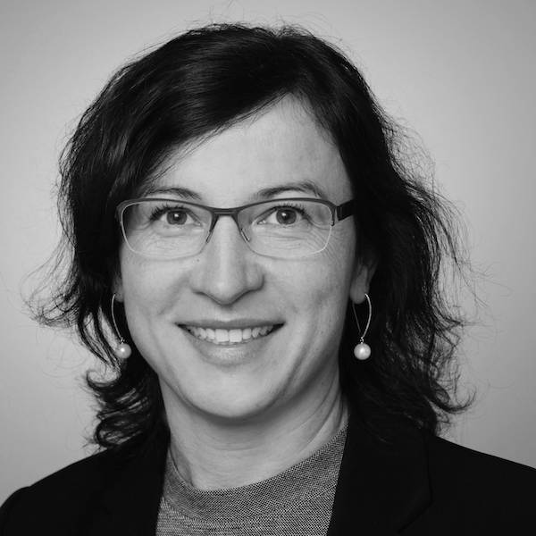
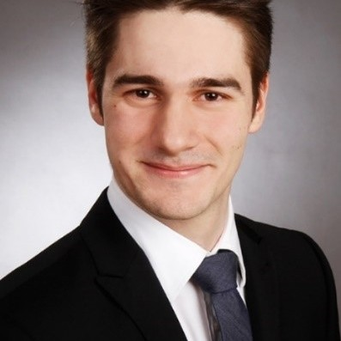
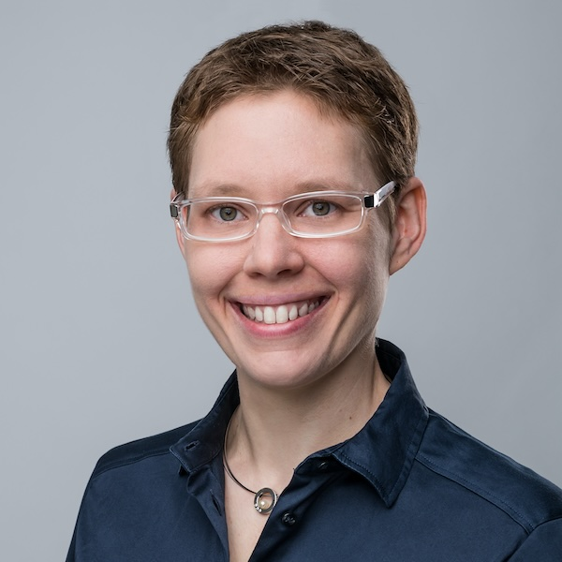
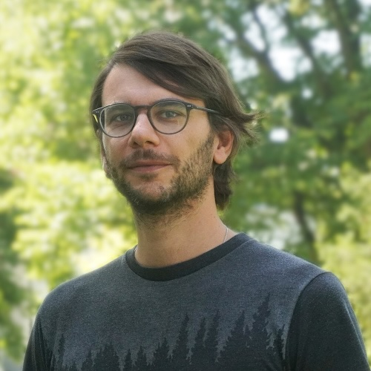
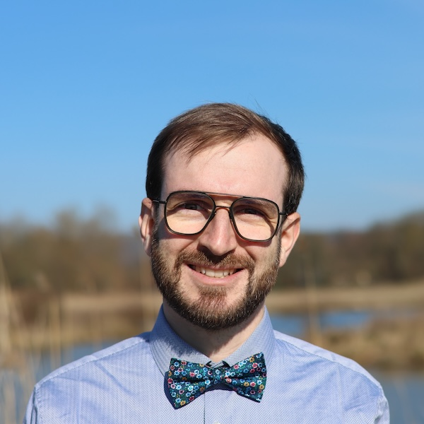
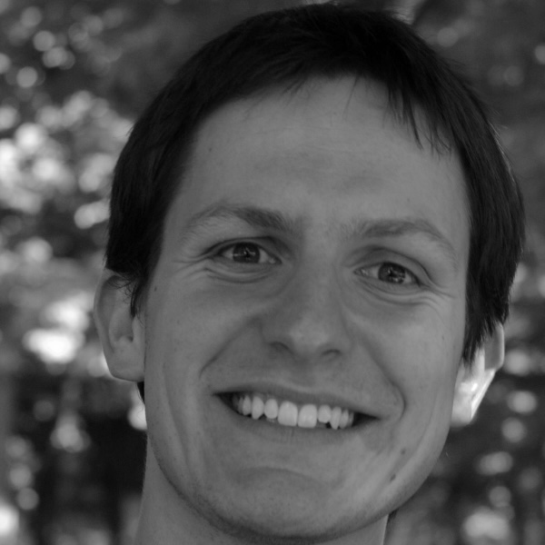
The RAIS² Executive Board and Managing Directors
Our members of the executive board
Our managing directors
Prof. Dr. Niklas Kühl
Professorship for Information Systems and Human-centric Artificial Intelligence
Prof. Dr. Agnes Koschmider
Professorship for Business & Information Systems Engineering and Process Analytics
Domenique Zipperling
Chair for Information Systems and Human-centric Artificial Intelligence
Prof. Dr. Lena Kästner
Professorship for Philosophy, Computer Science and Artificial intelligence
Prof. Dr. Johannes Margraf
Professorship for Physical Chemistry V: Theory and Machine Learning.
Dr. Timo Speith
Chair for Philsosophy, Computer Science and Artifical Intelligence
Prof. Dr. Mirco Schönfeld
Professorship for Data Modeling and Interdisciplinary Knowledge Generation

Slide 3
“We bring together the AI expertise of the University of Bayreuth to develop innovative AI-related methods and apply them responsibly in science, business, and society.”
Mission:
Vision:
“When utilized appropriately, AI enables scientific progress, sustainable innovation, and a society fit for the future.

Slide 4
RAIS is based on research in AI technology and its application in science and society.
RAIS²
AI for Life Science
AI for Materials
AI for Business and Industry
AI in Society
AI for Environmental Science
AI Technology

